Slide 1
React – Unit testing

Slide 2
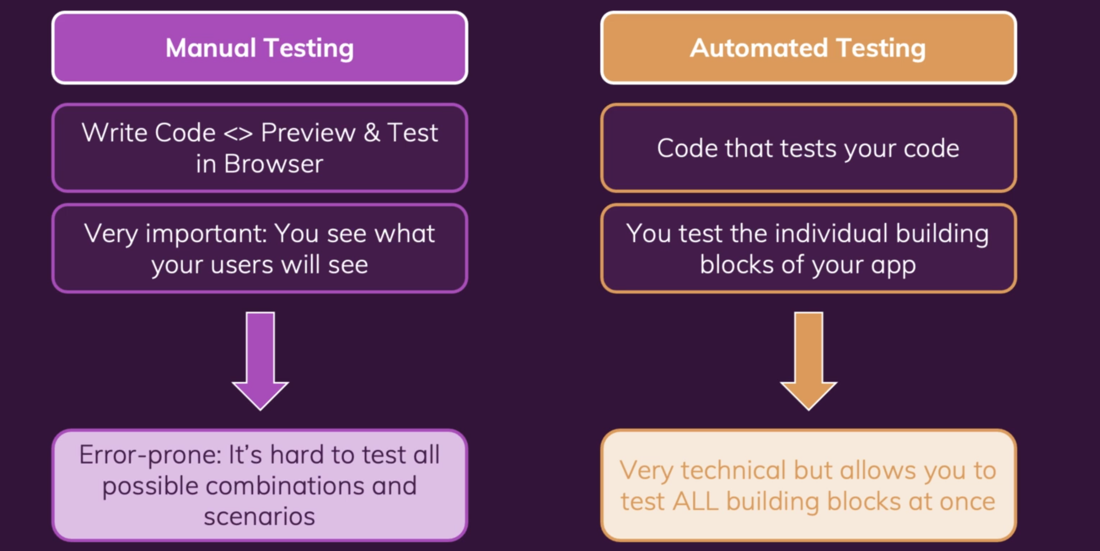
Unit testing React App

Slide 3
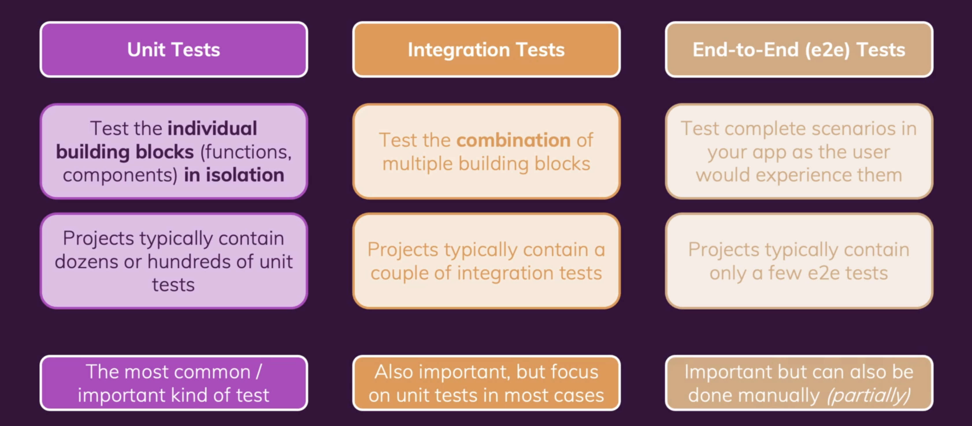
Different types of Automated tests

Slide 4
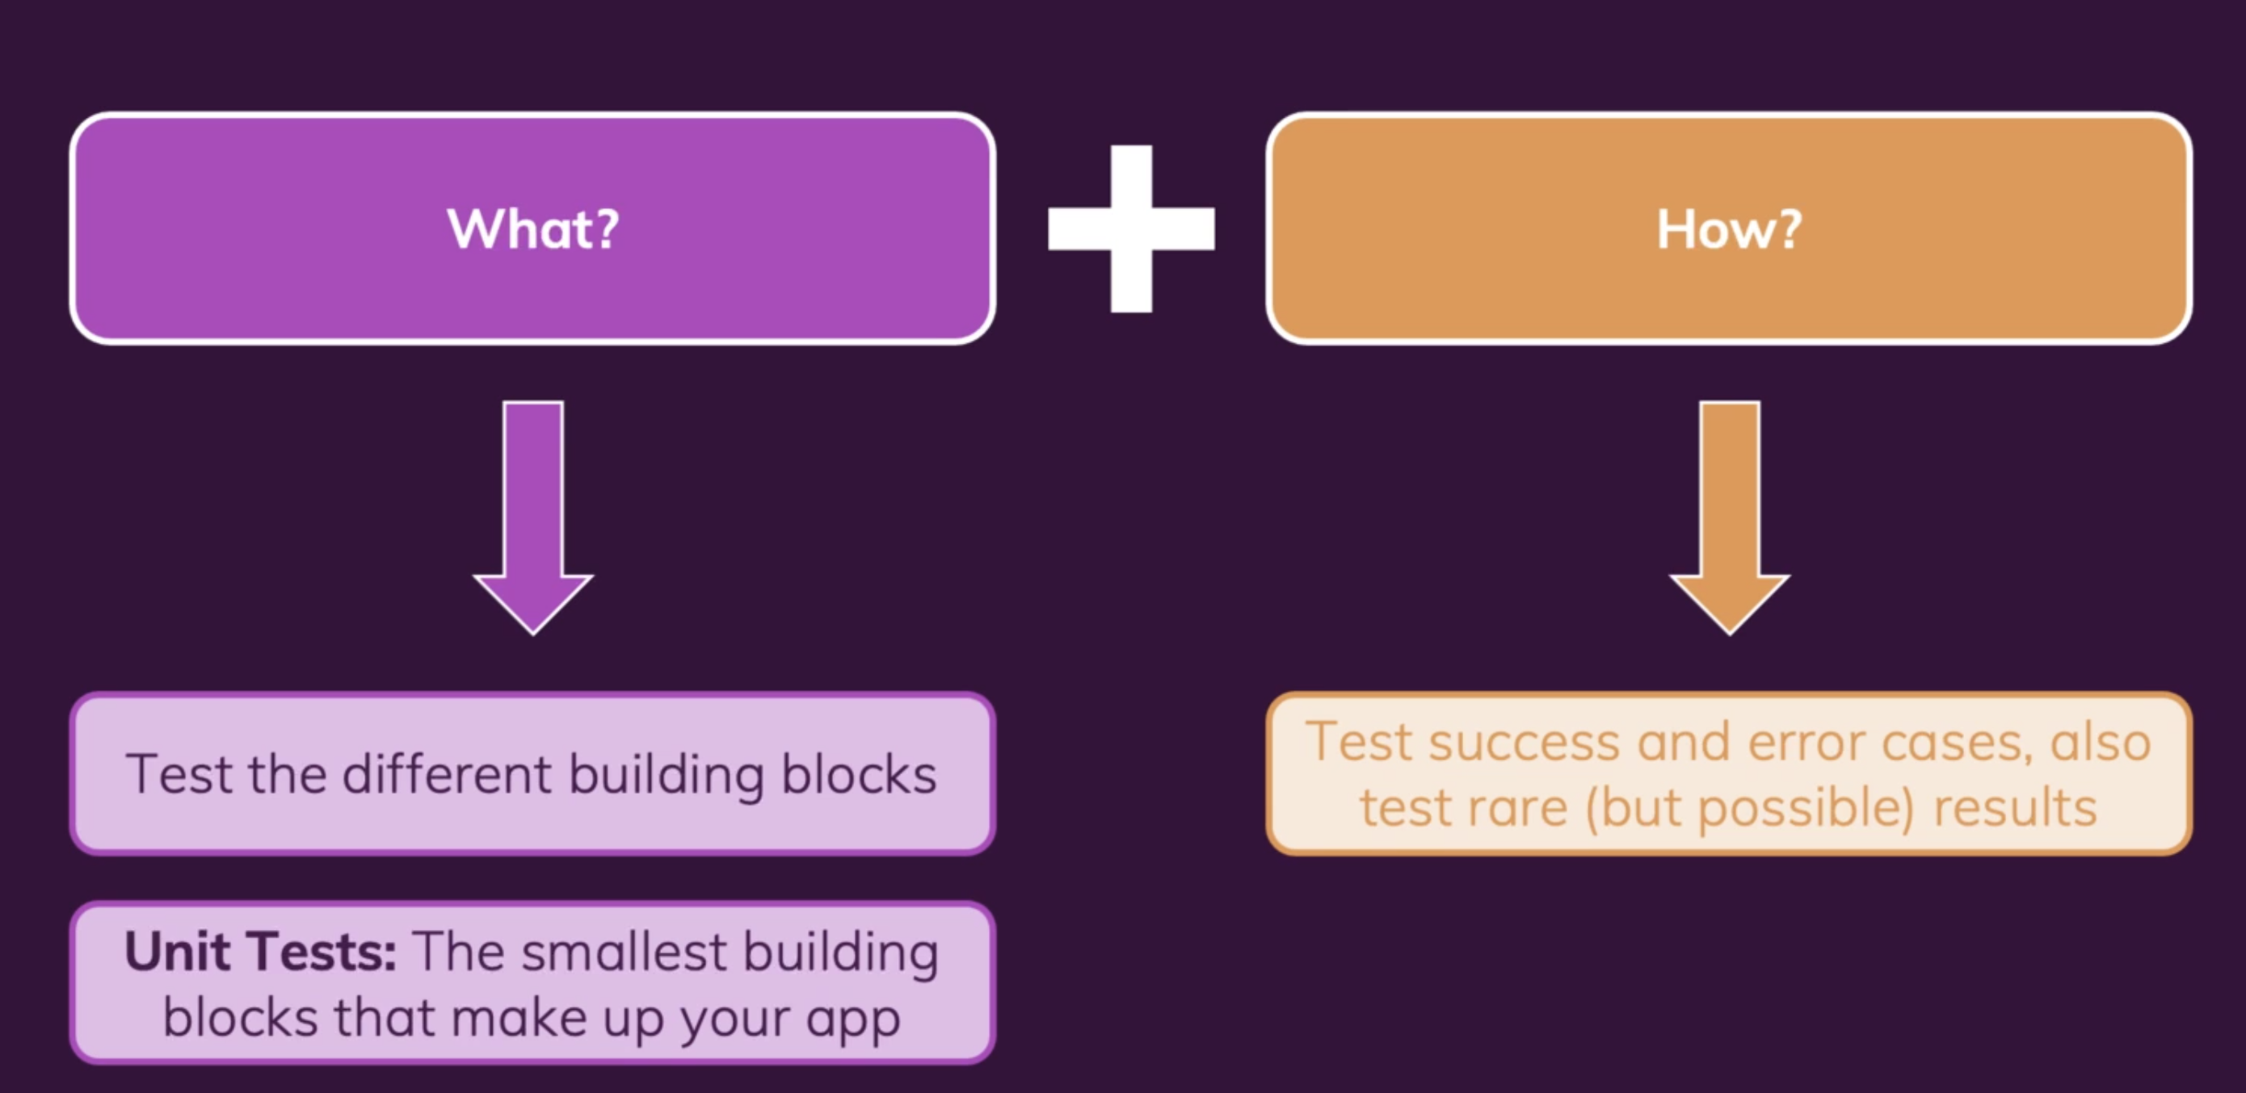
What to Test ?

Slide 5
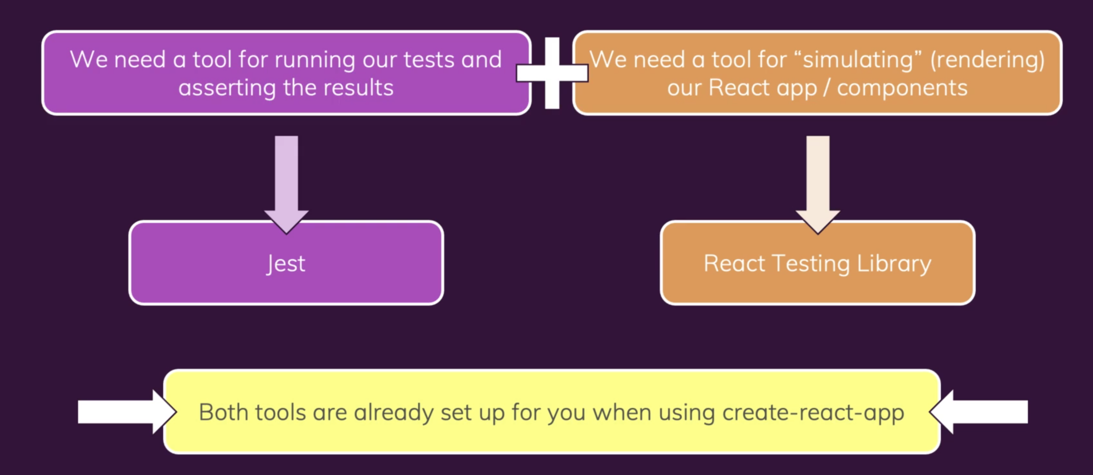
Required tools and Setup

Slide 6
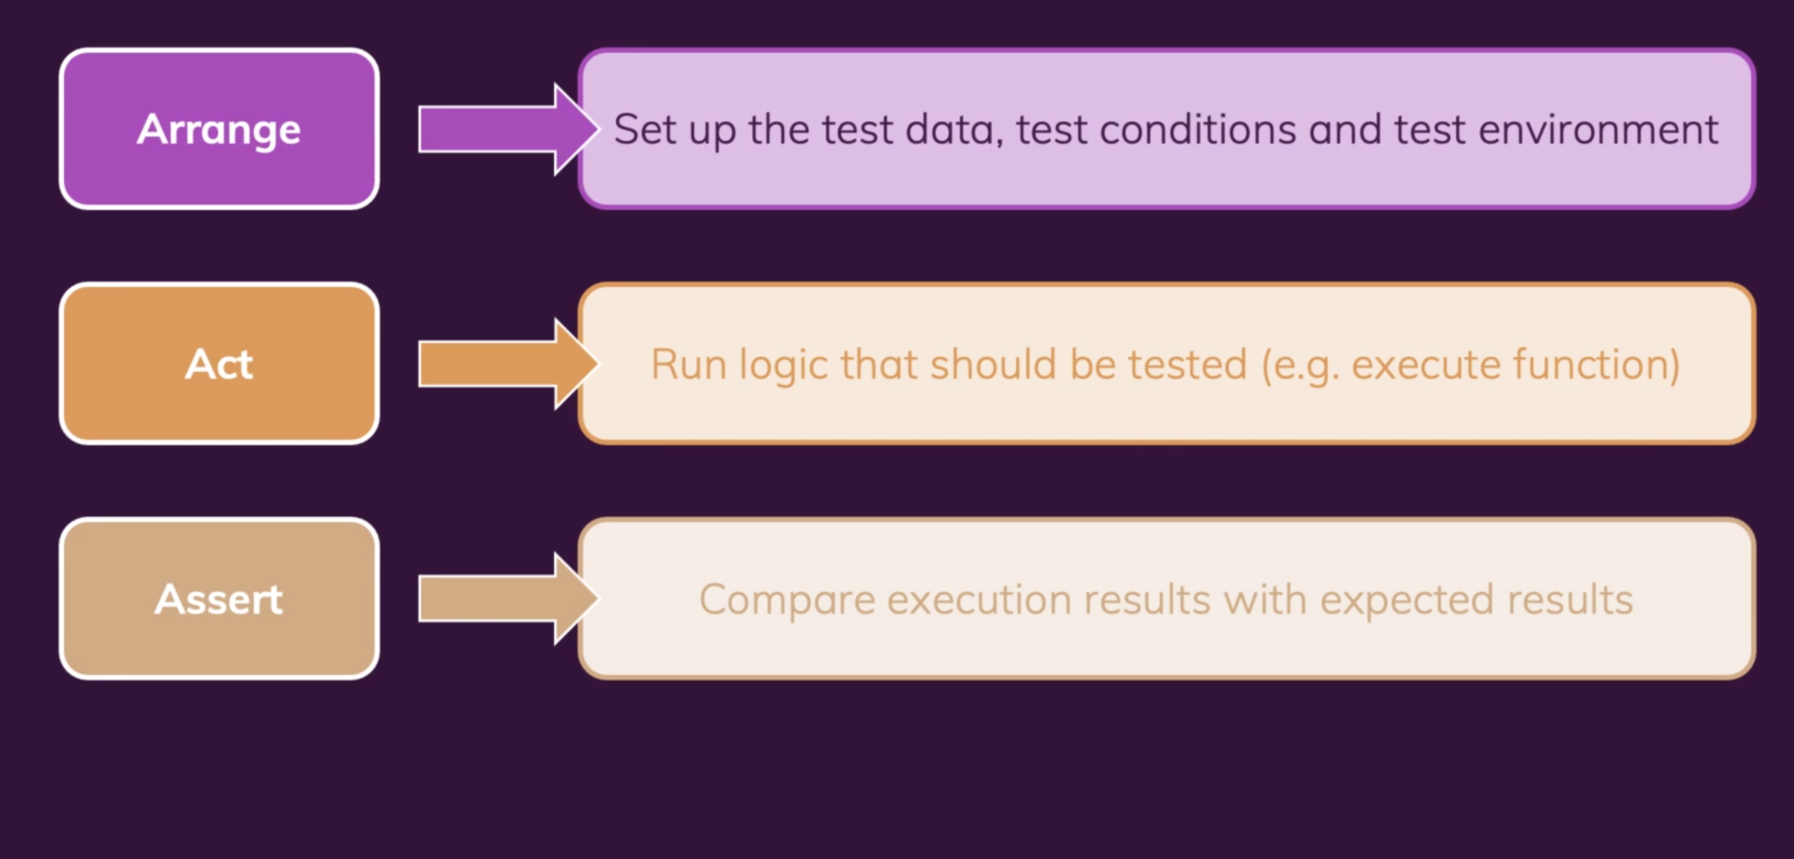
Three A’s

Slide 7
Let’s code first unit test…. ☺

Slide 8
Thank you ☺

